Slide 1

Incoming Receiving Inspector Training

Slide 2
Article
For the purpose of this training the term “Article” shall mean an aircraft, airframe, aircraft engine, propeller, appliance, or a component part.

Slide 3
Incoming Receiving
Why do we have them?

Slide 4
Incoming Receiving
To help insure the we never install an unairworthy part:
“On an Aircraft”

Slide 5
Incoming Receiving
Incoming inspection personnel shall verify that components received were produced under an FAA-approved process
These processes include: FAA-PMA (appropriate marking of article is required); FAA-TSO (appropriate marking of article is required);
OEM articles (appropriate documentation, such as Ship Tickets, Packing Slips providing traceability back to the manufacturer is required);
Direct Ship Authority (appropriate declaration of authority is required);
Certifications for standard articles, such as hardware items.
Notes:
Federal Aviation Administration (FAA)-Approved Parts. Under part 21, § 21.8, articles produced under an FAA-approved production system and which conform to FAA-approved data, may be approved under the following:
(1) A Parts Manufacturer Approval (PMA) issued under part 21 subpart K.
(2) A Technical Standard Order Authorization (TSOA) issued under part 21 subpart O.
See AC No: 20-62E Eligibility, Quality, and Identification of Aeronautical Replacement Parts

Slide 6
Incoming Receiving
Bonus Question:
What FAR are production of aviation parts regulated by?
Notes:
Part 21

Slide 7
Paperwork
 “Let me see your papers” 
What constitutes “paperwork” ?

Slide 8
Paperwork
For new aircraft parts……..
FAA Form 8130-3
EASA (JAA) Form 1
Serviceable Tag from another repair station.

Slide 9
Paperwork
For used serviceable aircraft parts……..
MHI “A Tag”
FAA Form 8130-3
EASA (JAA) Form 1
Serviceable Tag from another repair station

Slide 10
Paperwork
For used ☹ un-serviceable aircraft parts……..
MHI Tag
Unserviceable or Expendable or Repairable Tag
Unserviceable Tag from another repair station
Red tag parts (unsalvageable) 

Slide 11
Paperwork
What do you do with parts that do not have to proper documentation
Do not enter the parts into stock
Do not release them into the repair station

Slide 12
Paperwork
Determine “Service Life Limited Parts”
Should have Hard Card
Have Part Number & Serial Number
FAA Form 8130-3
Transcription of Total Time or Time Since Overhaul

Slide 13
Paperwork
Determine “Service Life Limited Parts”
If in doubt: Airworthiness Limitation
Chapter 4 or 5 
Found in S.B. for some engines

Slide 14
Examples
 “No No” ☹
Seat belts improperly repaired (from satellite repair station)
Major engine components (Fuel Control) that by-pass the IR inspection
Upholstery items

Slide 15
FAA Guidance
AC 20-154
Statement of purpose
Explanation of foreign country parts tags
Notes:
b. Approved Part. A part or part thereof that was designed, fabricated, produced, and/or
maintained under the appropriate regulation. This could include the following:
(1) Produced in accordance with a Parts Manufacturer Approval (PMA) issued under
part 21, subpart K.
(2) Produced in accordance with a Technical Standard Order Authorization (TSOA)
issued under part 21, subpart O.
(3) Produced during the TC application process under part 21, subpart B, or the STC
application process under part 21, subpart E, prior to the issuance of the certificate; subsequently
determined to conform to the approved TC or STC data (refer to part 21, section 21.303 (b)(1)).
(4) Produced under a TC without a separate production authorization, and an Approved
Production Inspection System (APIS), in accordance with part 21, subpart F.
(5) Produced under a Production Certificate (PC) (including production by a “licensee” if
produced under PC authority), in accordance with part 21, subpart G.
NOTE: A licensee is a person who has exclusive or nonexclusive rights to
apply for a PC (refer to part 21, section 21.133(a)(2)) under “licensing
agreement,” if they hold or have been awarded rights to the benefit of a
TC holder from the owner of the TC. The term licensing agreement does
not imply or infer that a PC holder may grant production approval to
any party on behalf of the FAA. Authority granted by a PC holder to a
supplier to ship parts directly to a customer of the PC holder is NOT
considered to be a licensing agreement.
alteration by an authorized part 145 repair station, or a U.S. air carrier having an approved CAMP under parts 121 and 135.
b. Foreign Manufactured Replacement Parts. New foreign manufactured parts for use on U.S. TC’d products may be imported when there is a Bilateral Airworthiness Agreement (BAA) between the country of manufacture and the United States, and the part meets the requirements under § 21.502.
(1) The certification may be verified on a form similar to the FAA Form 8130-3 (i.e., European Aviation Safety Agency (EASA), EASA Form One), used by European member countries of the EASA with which the United States has a BAA. The EASA is an organization of European member nations that has the responsibility to develop EASA regulations and policy.
Par 6 Page 5 AC 20-62E 12/23/10
The procedures and the countries with which the United States has BAA and the condition of the agreements, are contained in AC 21-23.
(2) Used parts may be identified by the records required for approval for return to service as set forth in § 43.9. FAA Form 8130-3 may be used for this purpose if the requirements of § 43.9 are contained in or attached to the form and approved for return to service by a U.S. FAA-certificated repair station or U.S. air carrier under the requirement of their CAMP. There is no set format or form required for a maintenance or alteration record. However, the data or information used to identify a part must be traceable to a person authorized to perform and approve for return to service maintenance and alterations under part 43. The records must contain a minimum that data set forth in § 43.9.
(3) The use of an authorization tag does not approve the installation of a part on a TC’d product. Additional substantiated authorization for compliance with part 43 and the FAA-approved data for major repairs and alterations may be required for installation on a TC’d product.

Slide 16
Authorized Release Certificate
What is it?
Bonus Question ?

Slide 17
Raw Materials
Must have an IR inspection
Sheet metal
Sealants
Lubricants
Fasteners
Petroleum distillates
Adhesives

Slide 18
Incoming Inspection
Visual Inspection Includes
Shipping Damage
State of Preservation
Shelf Life
Contamination
Verify ✓ AD’s – OEM Service Bulletins

Slide 19
Incoming Inspection
Approved Vendor List

Slide 20
ESDS
Electro – Static – Discharge - Sensitive

Slide 21
Articles
Purchased under an
Approved Process
Where would a description of these processes be found?
Bonus Question ☺

Slide 22
FAR Part 21
Approved Processes
TC
Production Certificate
TSO
PMA

Slide 23
FAR Part 21
Other Approved Processes
OEM Ship Ticket,
Packing Slip
Direct Ship Authority
Standard Hardware
Verify FAA Form Equivalent EASA Form , ect.

Slide 24
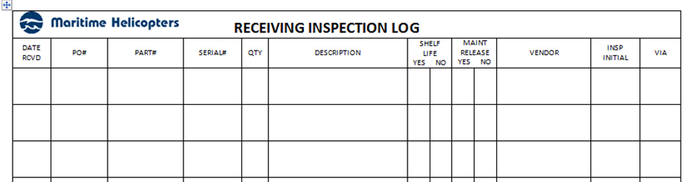
Incoming Receiving Inspection Log
Form HFS012will be kept on file in the incoming inspection area for a period of no less than two years.

Slide 25
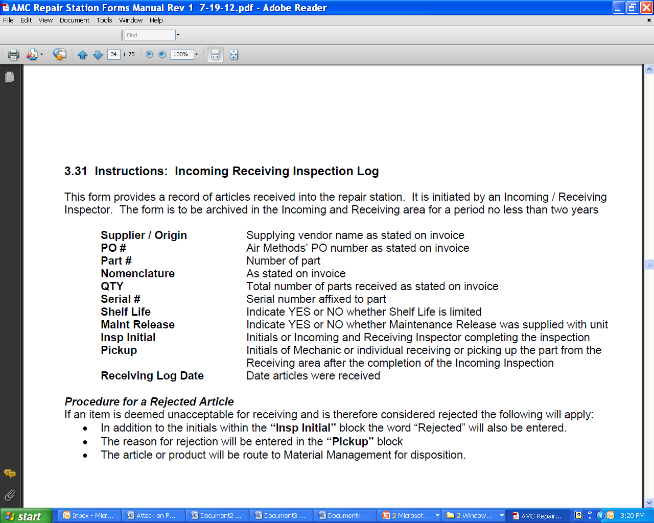

Slide 26
Quarantine
Rejected Items: Raw materials, hardware, equipment, or products received do not match any of the verifications or are found damaged they will be rejected, placed in quarantine
Suspected Unapproved Parts (SUPS – reference AC 21-29) will be quarantined by Quality Assurance.

Slide 27
Suspected Unapproved Parts
A part (article) that is indeed:
Manufactured, repaired, or has been administrated
In a manner that is outside of the system that we represent

Slide 28
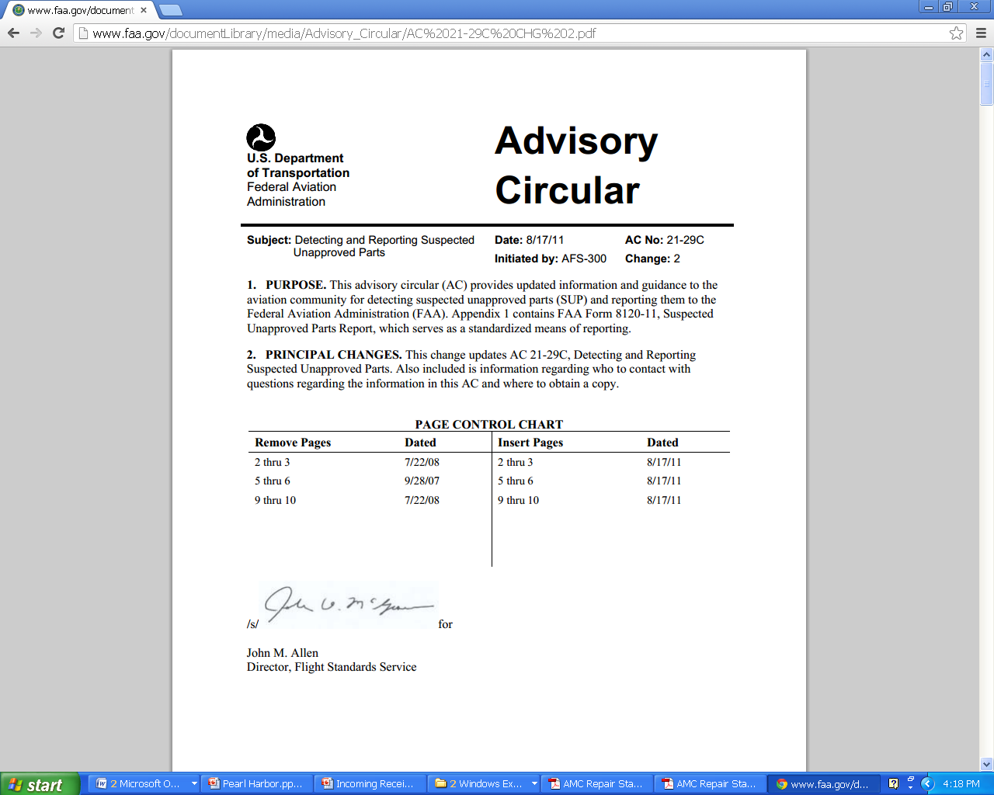
Detecting and Reporting Suspected Unapproved Parts

Slide 29
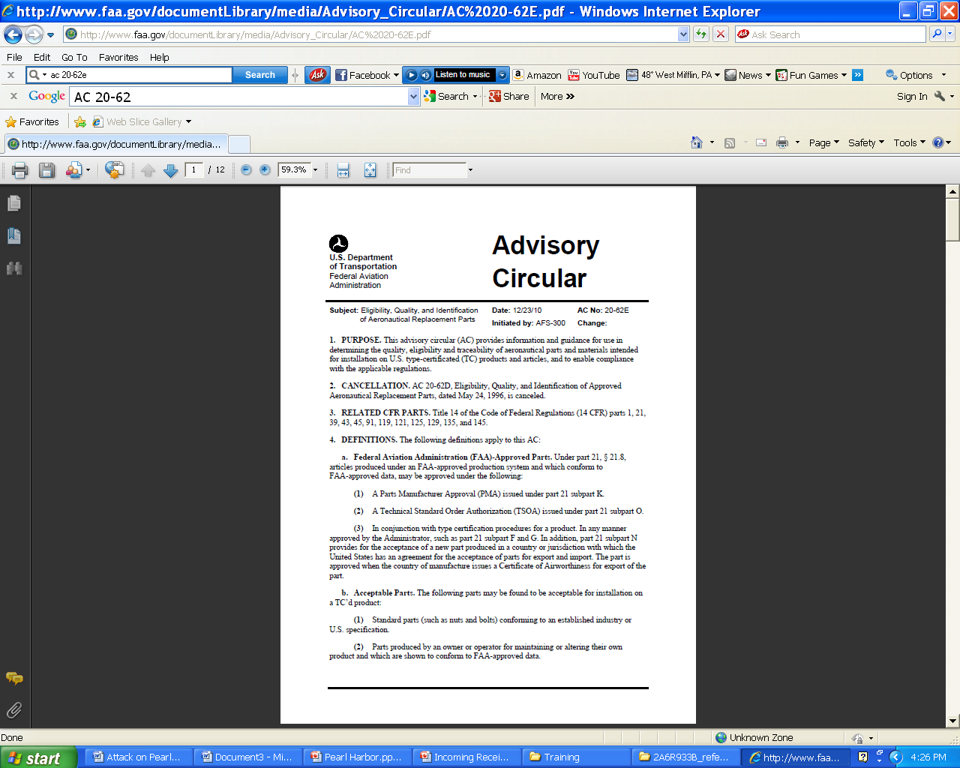
AC NO. 20-62E Eligibility, Quality, & Identification of Aeronautical Replacement Parts

Slide 30
END
Thank You

